Slide 1
CS2100 Tutorial
Control
will start at :05 as usual
Slides by Theodore, adapted from Prof. Aaron and Prof. Anandha’s slides

Slide 2
Assignment 1
I marked Q1+4+Admin; any questions ask after tutorial
Common mistakes:
using pow()
naming files wrongly
failing testcase (can't help for this)
Please check Q5
NA and 00 should be accepted for the relevant questions
Still check in case of spurious errors

Slide 3
Midterms
All the best :)
Open book, bring your "cheatsheet"
MIPS Sheet
Control signal from lecture / tutorial (?)
Anything else important to you
(Sometimes making your own "cheatsheet" helps with revision
Bring calculator

Slide 4
Generating ALUControl Signal
From lecture slide:
Opcode | ALUop | Instruction Operation | Funct field | ALU action | ALU control
lw |  | load word |  | add
sw |  | store word |  | add
beq |  | branch equal |  | subtract
R-type |  | add |  | add
R-type |  | subtract |  | subtract
R-type |  | AND |  | AND
R-type |  | OR |  | OR
R-type |  | set on less than |  | set on less than
Instruction Type | ALUop
lw / sw | 00
beq | 01
R-type | 10
00
xxxxxx
0010
00
xxxxxx
0010
01
xxxxxx
0110
10
10 0000
0010
10
10 0010
0110
10
10 0100
0000
ALUcontrol | Function
0000 | AND
0001 | OR
0010 | add
0110 | subtract
0111 | slt
1100 | NOR
10
10 0101
0001
10
10 1010
0111
Generation of 2-bit ALUop signal will be discussed later

Slide 5
Design of ALU Control Unit (1/2)
From lecture slide:
Input: 6-bit Funct field and 2-bit ALUop
Output: 4-bit ALUcontrol
Find the simplified expressions
ALUcontrol3 = 0
ALUcontrol2 =
ALUop0 + ALUop1⋅ F1
 | ALUop |  | Funct Field ( F[5:0] == Inst[5:0] ) |  |  |  |  |  | ALU control
 | MSB | LSB | F5 | F4 | F3 | F2 | F1 | F0
lw
sw
beq
add
sub
and
or
slt
0
0
X
X
X
X
X
X
0 0 1 0
0
0
X
X
X
X
X
X
0 0 1 0
X
0
1
X
X
X
X
X
X
0 1 1 0
1
0
1
0
0
0
0
0
0 0 1 0
X
X
X
1
0
1
0
0
0
1
0
0 1 1 0
X
X
X
1
0
1
0
0
1
0
0
0 0 0 0
X
X
X
1
0
1
0
0
1
0
1
0 0 0 1
X
X
X
1
X
X
X
0
1
0
1
0
1
0
0 1 1 1

Slide 6
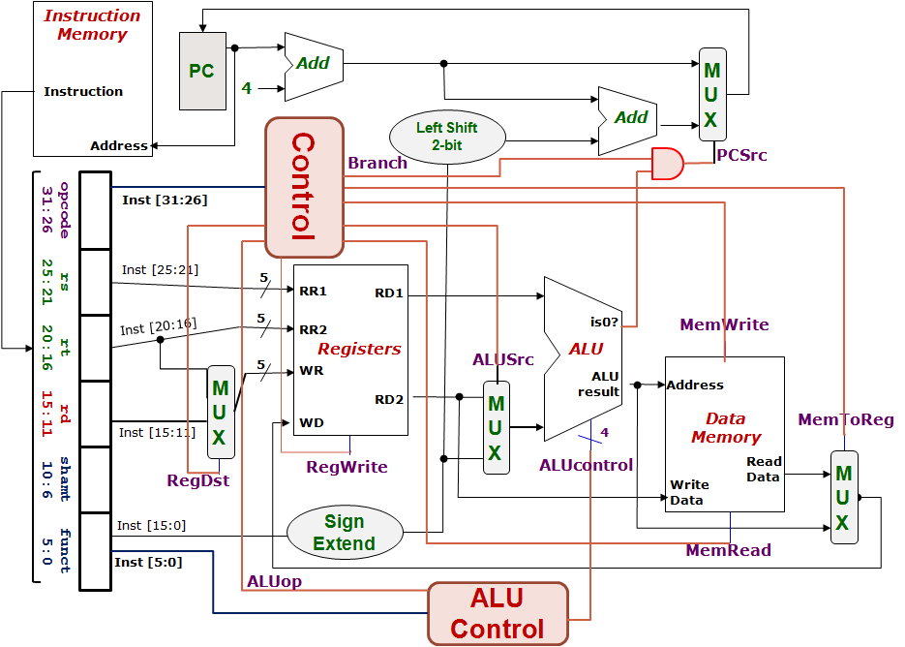
Control Design: Outputs
From lecture slide:
 | RegDst | ALUSrc | MemToReg | Reg Write | Mem Read | Mem Write | Branch | ALUop
 |  |  |  |  |  |  |  | op1 | op0
R-type
lw
sw
beq
1
0
0
1
0
0
0
1
0
0
1
1
1
1
0
0
0
0
X
1
X
0
0
1
0
0
0
X
0
X
0
0
0
1
0
1
0
1
0
1
0
1
1
0

Slide 7
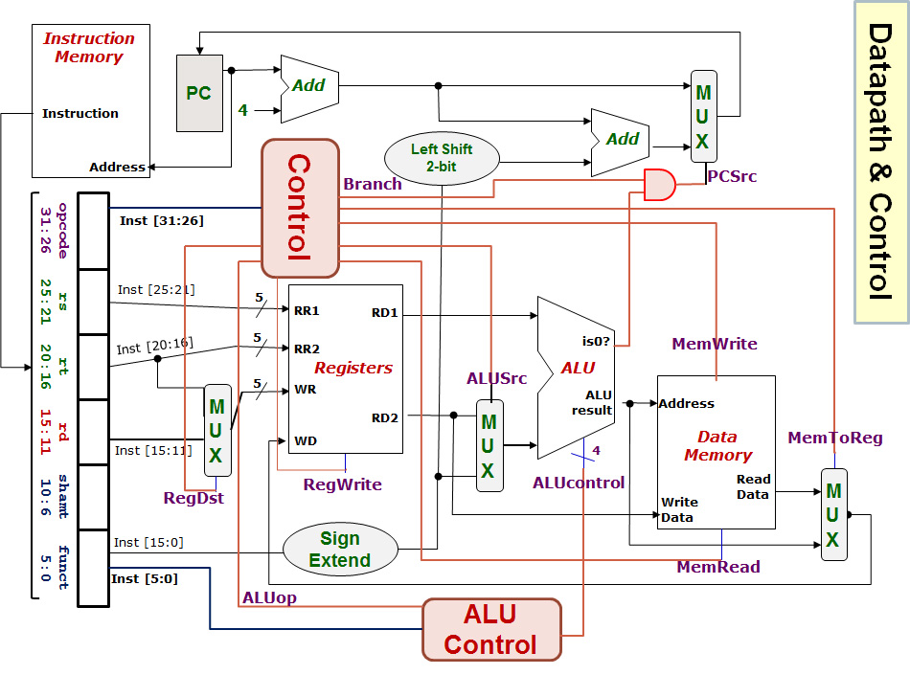
lw $24, 0($15)
R[rt] = M[R[rs]+SignExtImm]
100011 01111 11000 0000000000000000
Registers File |  |  |  | ALU |  | Data Memory
RR1 | RR2 | WR | WD | Opr1 | Opr2 | Address | Write Data
Q1(b)
Red means the data is actually used.
Blue means the data is not used.
$15
$24
$24
MEM([$15]+0)
[$15]
0
[$15]+0
[$24]
Next PC value = PC + 4
0
1
RegDest
RegWrite
ALUSrc
MemRead
MemWrite
MemToReg
Branch
ALUop
ALUcontrol
0
Easy, just copy from tables in previous slides.
1
0
1
100011
1
01111
0
Opr1
1
11000
0
0
1
0
00000 00000 000000
0
1
00
Opr2
1
0010
1
0
1

Slide 8
beq $1, $3, 12
If (R[rs]==R[rt]) PC=PC+4+BrAddr
000100 00001 00011 0000000000001100
Registers File |  |  |  | ALU |  | Data Memory
RR1 | RR2 | WR | WD | Opr1 | Opr2 | Address | Write Data
Q1(a)
$1
$3
$3 or $0
[$1]-[$3] or MEM([$1]-[$3])
[$1]
[$3]
[$1] – [$3]
[$3]
0
1
Next PC value = PC + 4
or (PC+4) + (12×4)
RegDest
RegWrite
ALUSrc
MemRead
MemWrite
MemToReg
Branch
ALUop
ALUcontrol
X
0
1
0
000100
0
00001
0
Opr1
X
00011
0
0
1
1
00000 00000 001100
0
1
01
Opr2
X
0
0110
1
0
X
0

Slide 9
sub $25, $20, $5
R[rd] = R[rs] – R[rt]
000000 10100 00101 11001 00000 100010
Registers File |  |  |  | ALU |  | Data Memory
RR1 | RR2 | WR | WD | Opr1 | Opr2 | Address | Write Data
Q1(c)
$20
$5
$25
[$20] – [$5]
[$20]
[$5]
[$20] – [$5]
[$5]
0
1
Next PC value = PC + 4
RegDest
RegWrite
ALUSrc
MemRead
MemWrite
MemToReg
Branch
ALUop
ALUcontrol
1
1
0
0
000000
0
10100
0
Opr1
0
00101
0
0
1
0
11001
0
1
10
Opr2
1
0110
00000
1
0
100010
0

Slide 10
SUB instruction
Inst-Mem (400)
Reg.File (200)
MUX (ALUSrc)
(30)
ALU
(120)
MUX (MToR)
(30)
Reg.File
(200)
Control (100)
Q2(a)
Not critical path
Inst-Mem
400ps
-------------
Adder
100ps
-------------
MUX
30ps
-------------
ALU
120ps
-------------
Reg-File
200ps
-------------
Data-Mem
350ps
-------------
Control/ALUControl
100ps
-------------
Lshft/signext/AND
20ps
400+200+30+120+30+200 = 980ps
0
1
0
1
0
1
0
1
1
0

Slide 11
LW instruction
Inst-Mem (400)
Reg.File (200)
ALU
(120)
DataMem
(350)
MUX (MToR)
(30)
Reg.File
(200)
Control (100)
Q2(b)
Not critical path
Inst-Mem
400ps
-------------
Adder
100ps
-------------
MUX
30ps
-------------
ALU
120ps
-------------
Reg-File
200ps
-------------
Data-Mem
350ps
-------------
Control/ALUControl
100ps
-------------
Lshft/signext/AND
20ps
400+200+120+350+30+200 = 1300ps
0
1
0
1
0
1
1
0
Why is MUX (ALUSrc) not included this time?

Slide 12
Prelude: "returning" multiple things in C
Use pointers in argument to "return" multiple things
void func(int a, int b, int *ret1, int *ret2) {
int y = a – b;
*ret1 = a + b;
*ret2 = y > 0 ? y : -1 * y;
}

Slide 13
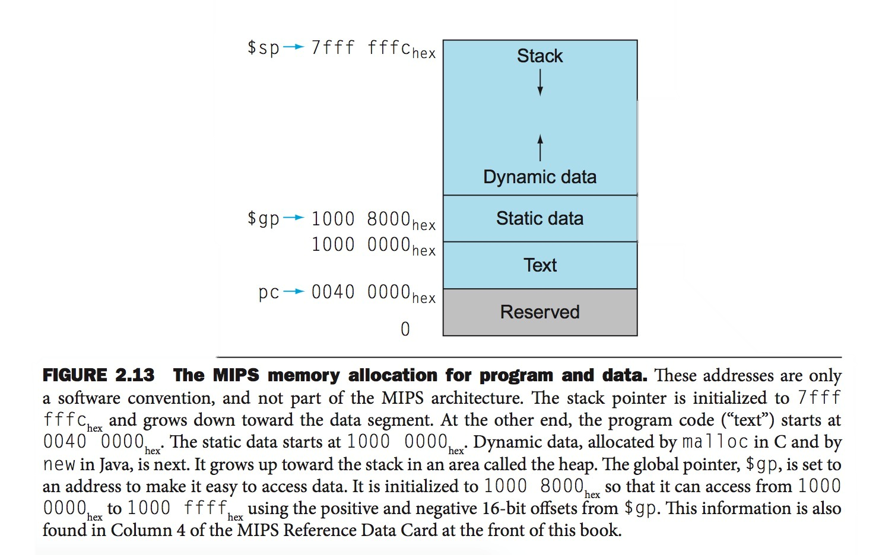
Questions 3, 4, 5, 6, 7
What's going on:
Imagine you're writing an emulator: you will need to simulate what the hardware does in code
What this means:
Find the 'code' (in C for this module) that simulates what each of the components do
For example, we have the Instruction Memory:
"Text segment" from 0x0040 0000 to 0x1000 0000, so we have 0x0FC0 0000 bytes of Instr. Mem.
Represent that by uint32_t instr_mem[264241152]

Slide 14
Q3a) Register file
Now we're simulating the register file.
What is the data in the register file?
What stuff do we do with the register file?

Slide 15
Q3a) Register file
Now we're simulating the register file.
What is the data in the register file?
32 registers, each with 32-bit field
What stuff do we do with the register file?
We get RR1/RR2/WR/WD/RegWrite
We pass RD1 and RD2 out
Remember how to "return" multiple things?
We might need to modify the register file
This happens when RegWrite is 1

Slide 16
Q3a) Register file
Now we're simulating the register file.
What is the data in the register file?
32 registers, each with 32-bit field
How to simulate this:
int32_t rf[32];

Slide 17
Q3a) Register file
Now we're simulating the register file.
What stuff do we do with the register file?
We get RR1/RR2/WR/WD/RegWrite
=> simulated as arguments to function
We pass RD1 and RD2 out
=> simulated as "return" values
We might need to modify the register file
=> the body of the function

Slide 18
Q3a
Just an array of integers to store the registers content. The index shall be the name (i.e., register number) of the register
int32_t rf[32];
void RegFile(uint5_t RR1,
uint5_t RR2,
uint5_t WR,
int32_t WD,
int32_t *RD1,
int32_t *RD2,
bool RegWrite) {
// Because we need to send out multiple outputs,
// we will use passing by pointers.
*RD1 = (RR1 > 0) ? rf[RR1] : 0;
*RD2 = (RR2 > 0) ? rf[RR2] : 0;
if (RegWrite && WR)
rf[WR] = WD;
}
Since we need to return two outputs, we will need to pass them back via pointers
Make sure that register 0 returns a 0
Make sure that we never write to register 0. Actually, harmless coz you can never read the content back. Still, just for completeness
We can use C’s conditional statement or if-then-else. Both are perfectly fine

Slide 19
Q3b) Data Memory
Now we're simulating the data memory.
What is the data memory?
The simplification is always "a large array"
What stuff do we do with data memory?
Input: Address, Write Data
Input: MemWrite, MemRead
Output: ReadData

Slide 20
Q3b
int32_t data_memory[1073741824];
int32_t AccessDataMemory(uint32_t address,
int32_t WrData,
bool MemRead,
bool MemWrite)
{
// We can do a sanity check here.
// You can at most do one memory operation.
// Will assume that "error" raises hell.
if (MemRead && MemWrite) {
error("Cannot do both read and write at the same time.")
}
if (MemRead) {
return data_memory[address];
}
if (MemWrite) {
data_memory[address] = WrData;
return 0;
}
}
Ridiculous number but without introducing OS, we will just live with this for now
Simple error checking
Straightforward

Slide 21
Macro processing is kind of automated text processing of your source code before it is passed to the compiler. It is useful especially for shortening repetitive coding. Not just save space but also so that you only need to fix one piece of code instead of fixing all the repeated copies. In the repetition process, it can also allow the programmer to vary some parts of the repetition on a case by case basis
Q4
Macro “MUX” defined with “N” as a parameter
Token pasteing: the token “uint” is pasted with the value of parameter N and then with “_t”
Token pasteing: the token “mux” is pasted with the value of parameter N to form a new token
In macro, one line, one statement. If what you want to write spans multiple lines, continuation of must be made explicit by “\”
MUX(8);
As a result…
#define MUX(N) \
uint##N##_t mux##N##(uint##N##_t in0, \
uint##N##_t in1, \
bool ctrl) \
{ \
if (ctrl) return in1; \
else return in0; \
}
uint8_t mux8(uint8_t in0,
uint8_t in1, bool ctrl)
{
if (ctrl) return in1;
else return in0;
};
This will be instantiated at where “MUX(8);” occurs in the source file, before passing it to the C compiler
The semicolon here is due to “MUX(8);” written with a semicolon. It is copied verbatim. It makes “MUX(8);” look like a valid C statement and when expanded the semicolon is harmless as the result is still acceptable in C

Slide 22
Q5
(a) _RegDst
if (!opcode) *_RegDst = 1;
else *_RegDst = 0;
(b) _ALUSrc
if (!opcode || opcode == 4) *_ALUSrc = 0;
else *_ALUSrc = 1;
(c) _MEMRead
if (opcode == 0x23) *_MemRead = 1;
else *_MemRead = 0;
(d) _ALUOp
switch (opcode) {
case 0: *_ALUOp = 2;
case 0x23: // lw
case 0x2b: *_ALUOp = 0; // sw
case 0x4: *_ALUOp = 1; // beq
}

Slide 23
Q6
uint4_t ALUControl(uint2_t _ALUOp, uint6_t _funct) {
if (_ALUOp == 2) { // R-type; need to decode funct
switch (_funct) {
case 0x20: return 2; // add
case 0x22: return 6; // sub
case 0x24: return 0; // and
case 0x25: return 1; // or
case 0x27: return 0xC; // nor
case 0x2a: return 7; // slt
default: // raise an error
}
}
else { // non R-type
if (_ALUOp == 0)
return 2; // Ask ALU to add
if (_ALUOp == 1)
return 6; // Ask ALU to subtract
}
}
ALUcontrol | Function
0000 | AND
0001 | OR
0010 | add
0110 | subtract
0111 | slt
1100 | NOR

Slide 24
int32_t ALU(int32_t in0, int32_t in1, uint4_t ALUcontrol, bool *ALUiszero)
{
int32_t result;
switch (ALUcontrol) {
case 0:
result = in0 & in1;
break;
case 1:
result = in0 | in1;
break;
case 2:
result = in0 + in1;
break;
case 6:
result = in0 - in1;
break;
case 7:
result = (int32_t)(in0 < in1);
break;
case 12:
result = ~(in0 | in1);
break;
}
*ALUiszero = (result == 0);
return(result);
}
Q7
in1 may be rt or immed. But this is settled prior to invoking the ALU
ALUcontrol | Function
0000 | AND
0001 | OR
0010 | add
0110 | subtract
0111 | slt
1100 | NOR
Our input parameters are signed. So we are doing signed comparison here
ALUiszero passed by pointer and is always set based on the result
We use the bitwise complement (NOT) of C. Cannot use logical NOT “!”

Slide 25

End of Tutorial 5
Slides uploaded on github.com/theodoreleebrant/TA-2425S1
Email: theo@comp.nus.edu.sg
Anonymous feedback:
bit.ly/feedback-theodore
(or scan on the right)
(Also reminder for me to take attendance)

